Slide 1
Module 3 Week 2

Slide 2
DynamoDB Internals Roadmap
Week 2
Week 1 Review
New DynamoDB Functionality
DynamoDB Components
Items
Attributes
Attribute types
Partition Keys & Sort Keys
Global & Local Secondary Index
Create tables
Scan/Query data
CRUD operations
Lab 2

Slide 3
Week 1 Review

Slide 4
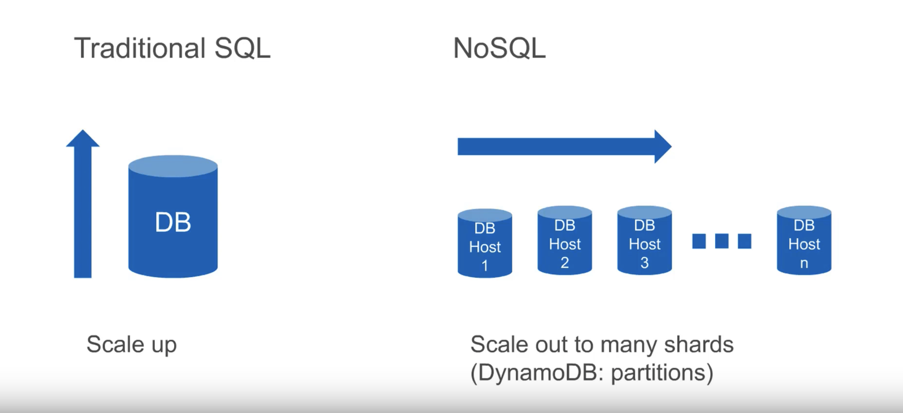
Scaling RDBMS vs NoSQL databases

Slide 5
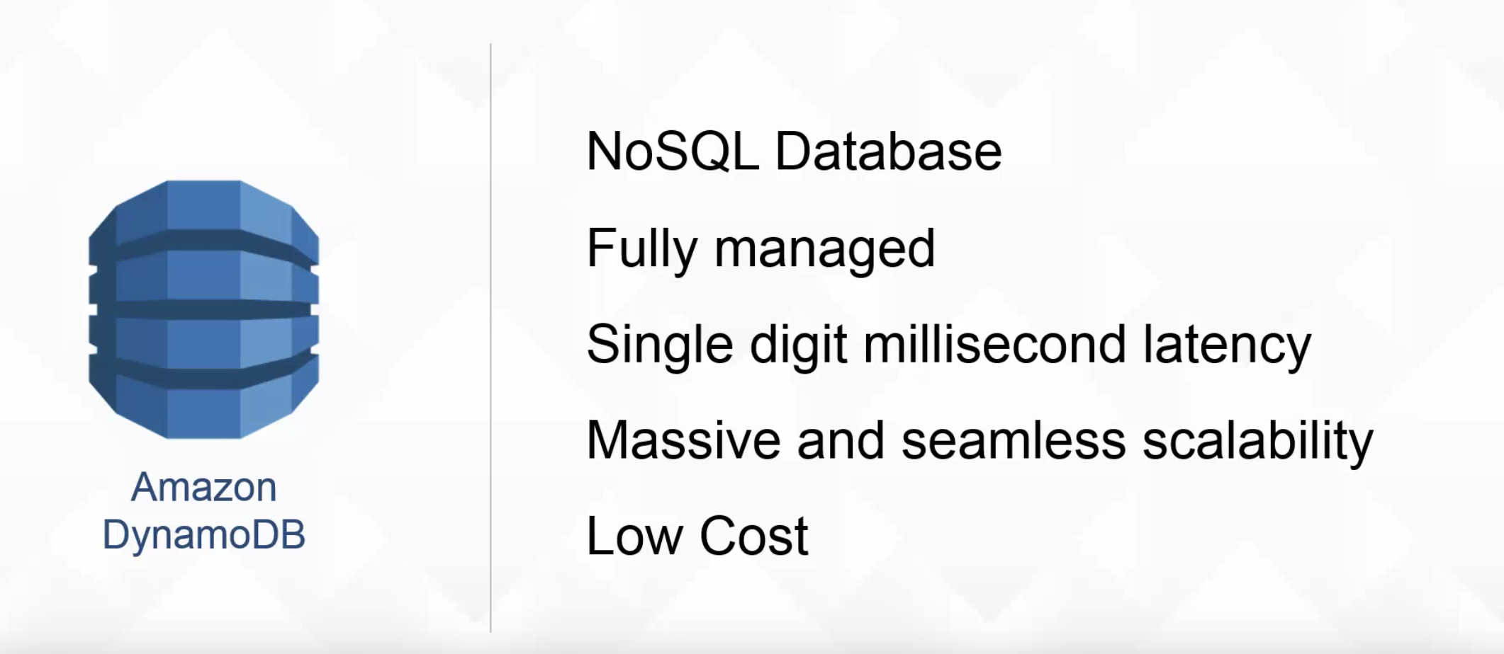
DynamoDB

Slide 6
DynamoDB
DynamoDB supports BASE
(BA) – Basically available
Can be failure in some parts of distributed system and the rest of the system will continue to function
(S) – Soft state
Data maybe eventually overwritten by more recent data
(E) - Eventually consistent
Sometimes a database might be in inconsistent state

Slide 7
DynamoDB
Hard to scale transactions in RDBMS
Need to partition the database across multiple machines
If a transaction touches one machine, life is good
If a transaction touches multiple machines, ACID becomes very expansive
Replication in RDBMS
Replication can help to increase throughput and lower latency
Can create multiple copies of each database partition
Spread queries across these replicas
Easy for reads but writes can be very expansive

Slide 8
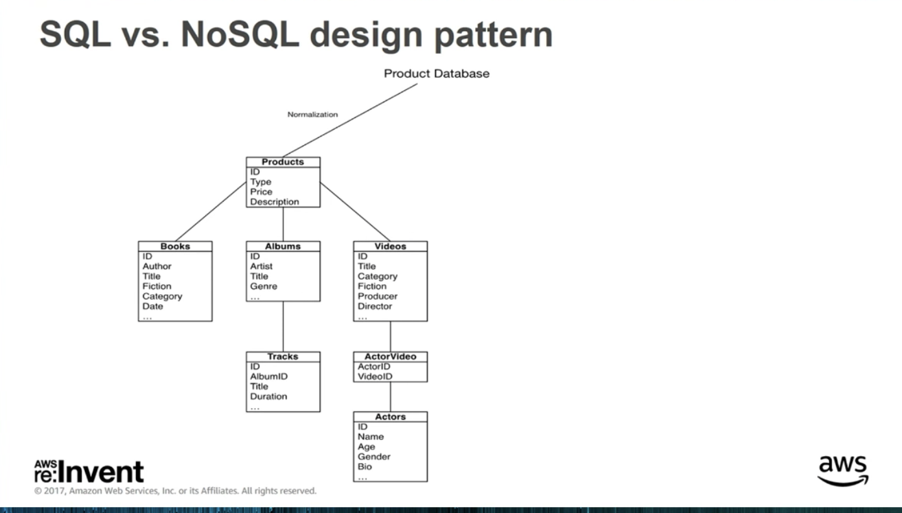

Slide 9
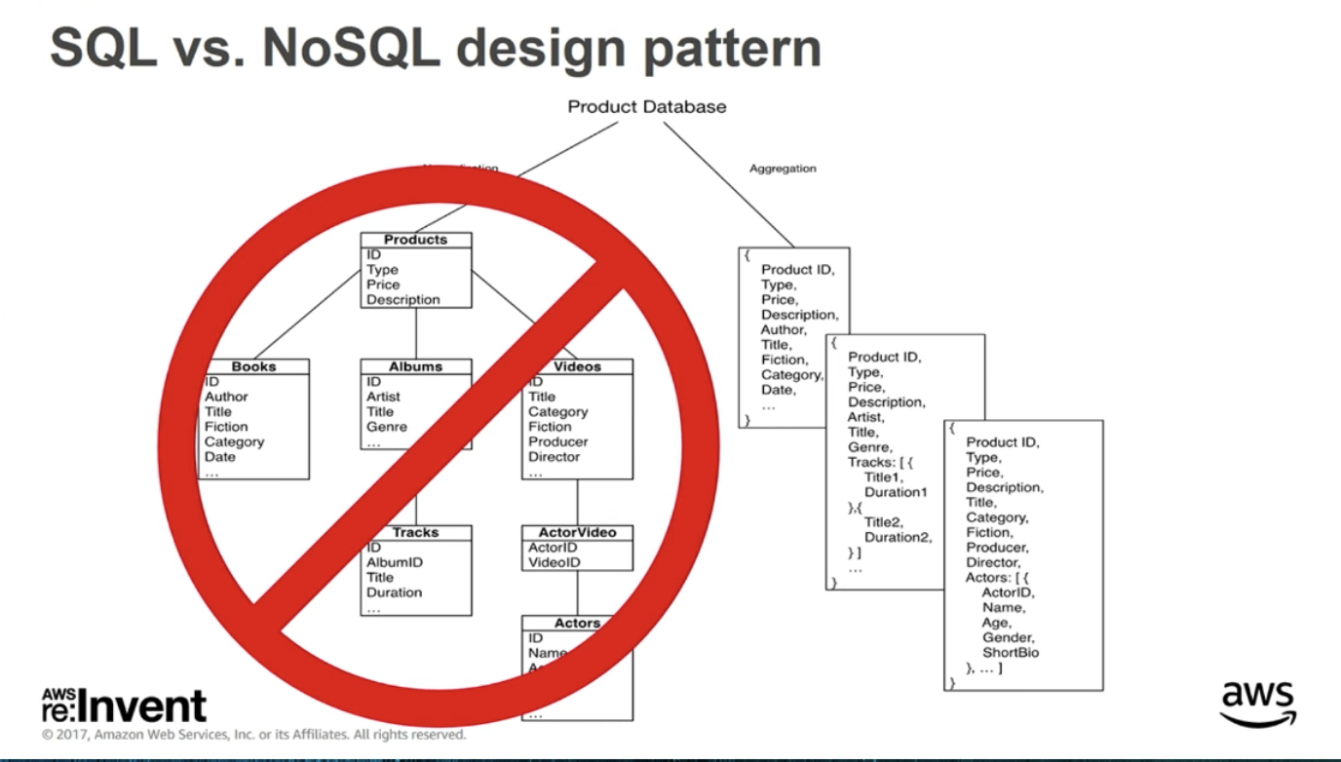

Slide 10
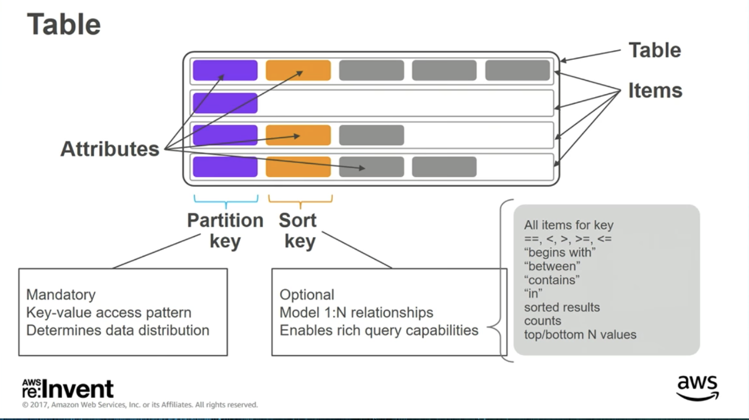
DynamoDB Data Model

Slide 11
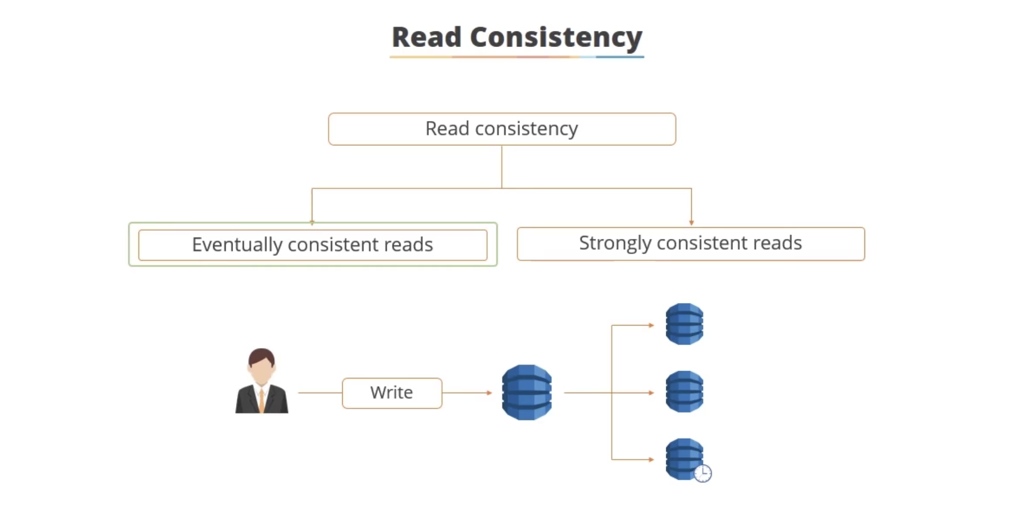
DynamoDB

Slide 12
DynamoDB vs RDBMS
RDBMS
Schema is static
Strong consistency is a must
Data not going to be big in volume
DynamoDB
Schema evolving over time
Storage will be very big
Operations involved are ok to eventually consistent

Slide 13
RDBMS vs NoSQL Consistency
RDBMS
Consistency ensures that transaction can only bring database from one valid state to another
Any data written to database must be valid according to rules
NoSQL
Read request for an entity to any of the nodes should return the same data
Eventual consistency makes sure that data of each node gets consistent eventually

Slide 14
DynamoDB vs RDBMS
RDBMS | DynamoDB
Tables | Tables
Rows | Items
Columns | Attributes
Primary Key | Partition Key Partition Key + Sort Key
Index | Global Secondary Index Local Secondary Index

Slide 15
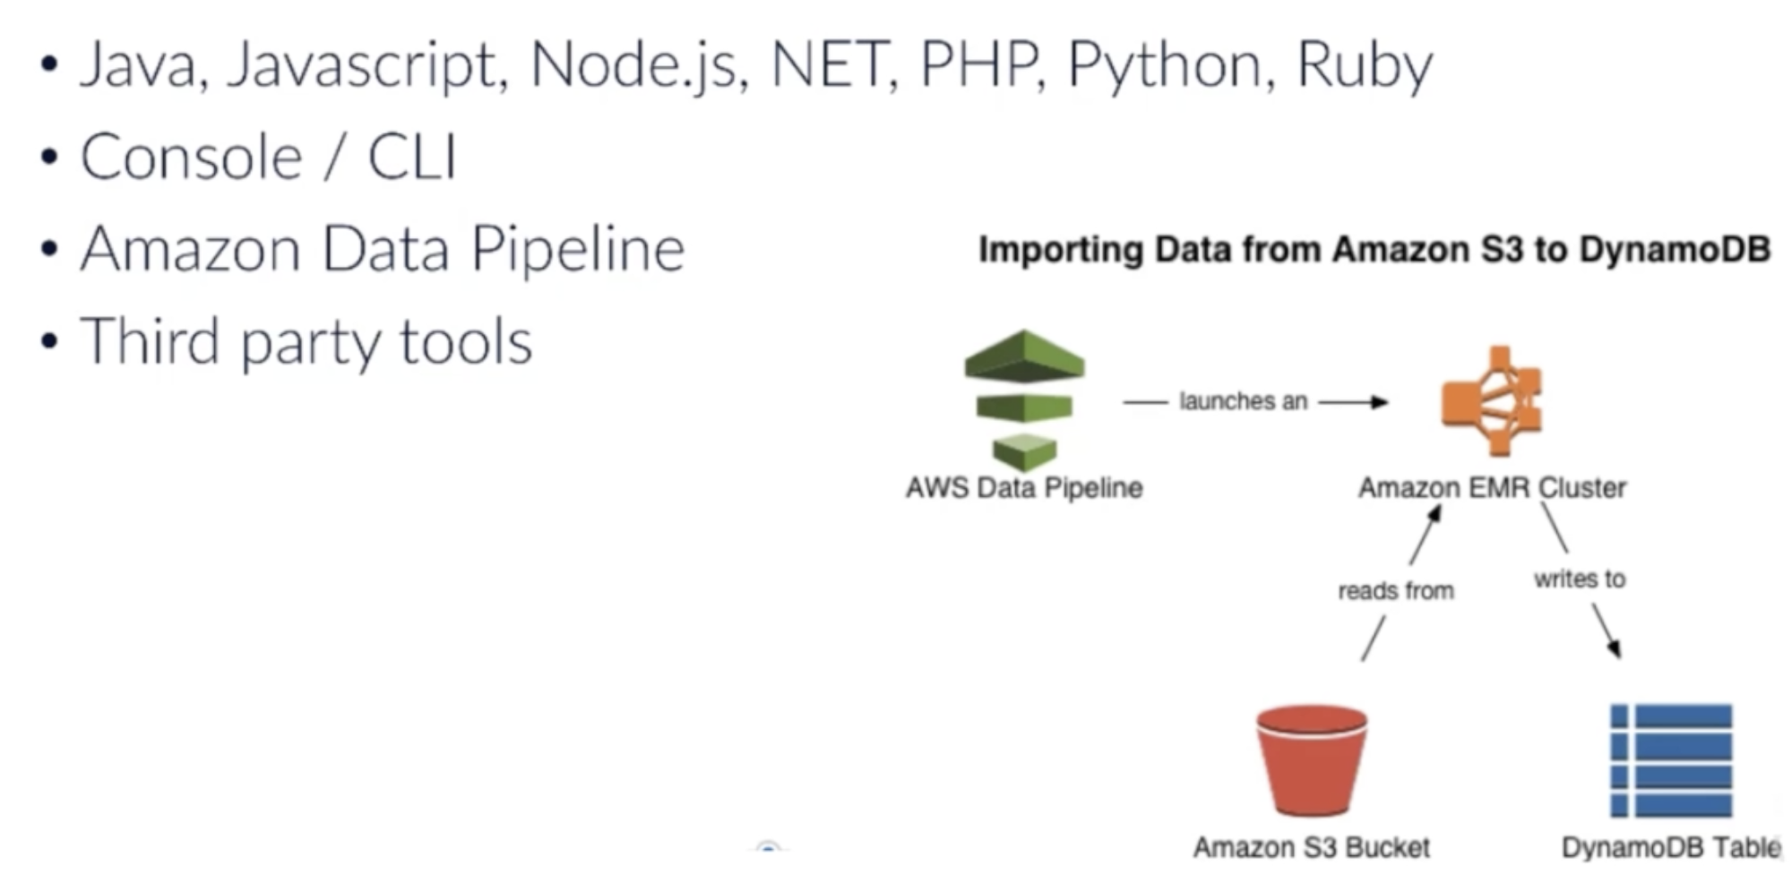
Loading Data into DynamoDB

Slide 16
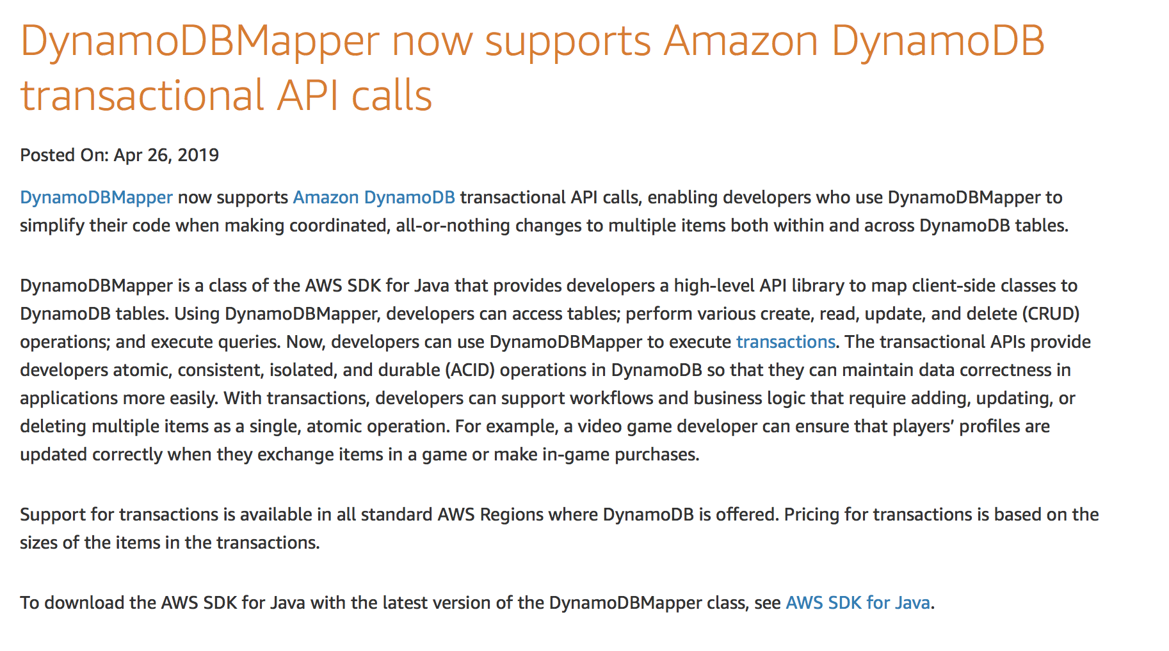
New DynamoDB Functionality

Slide 17
New DynamoDB Functionality
DynamoDB Transactional APIs
DynamoDB now supports up to 25 unique items and 4 MB of data per transaction
Transactions enable developers to simplify their code, support workflows and business logic
Can add, update or delete multiple items as a single all-or-nothing operation
DynamoDB transactions are ACID compliant
https://docs.aws.amazon.com/amazondynamodb/latest/developerguide/transactions.html

Slide 18
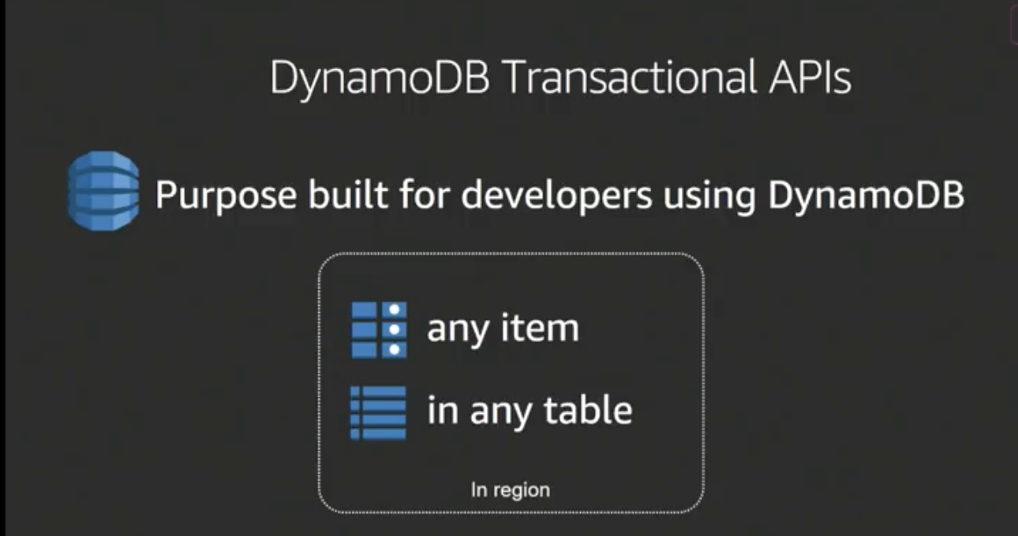
New DynamoDB Functionality

Slide 19
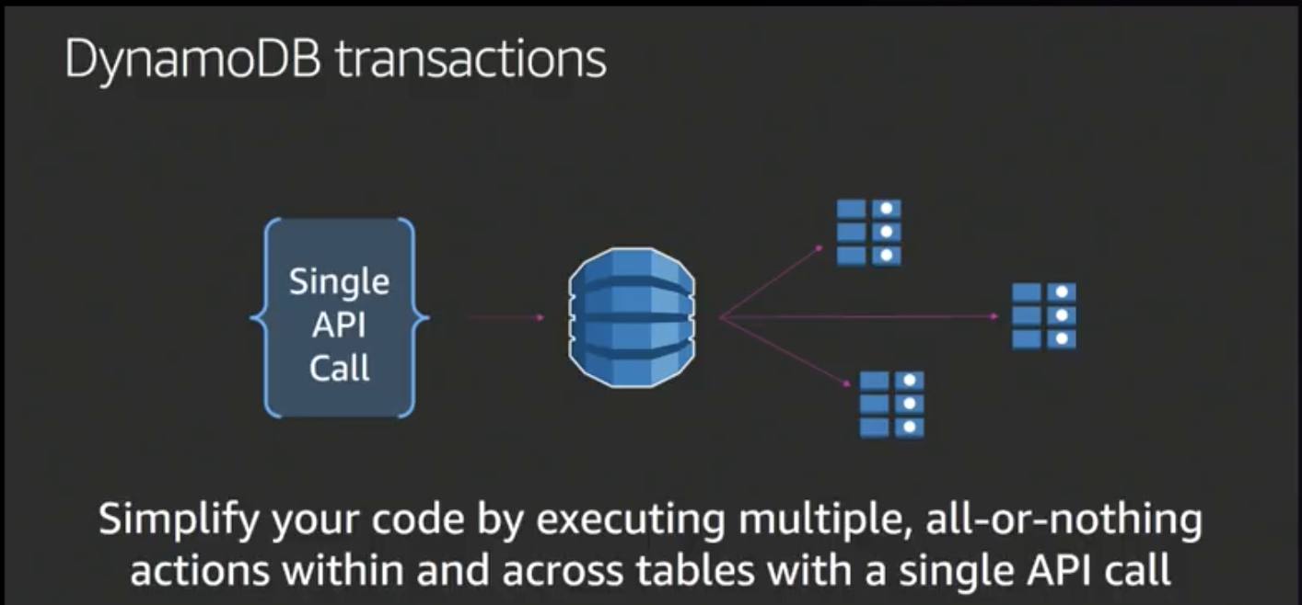
New DynamoDB Functionality

Slide 20
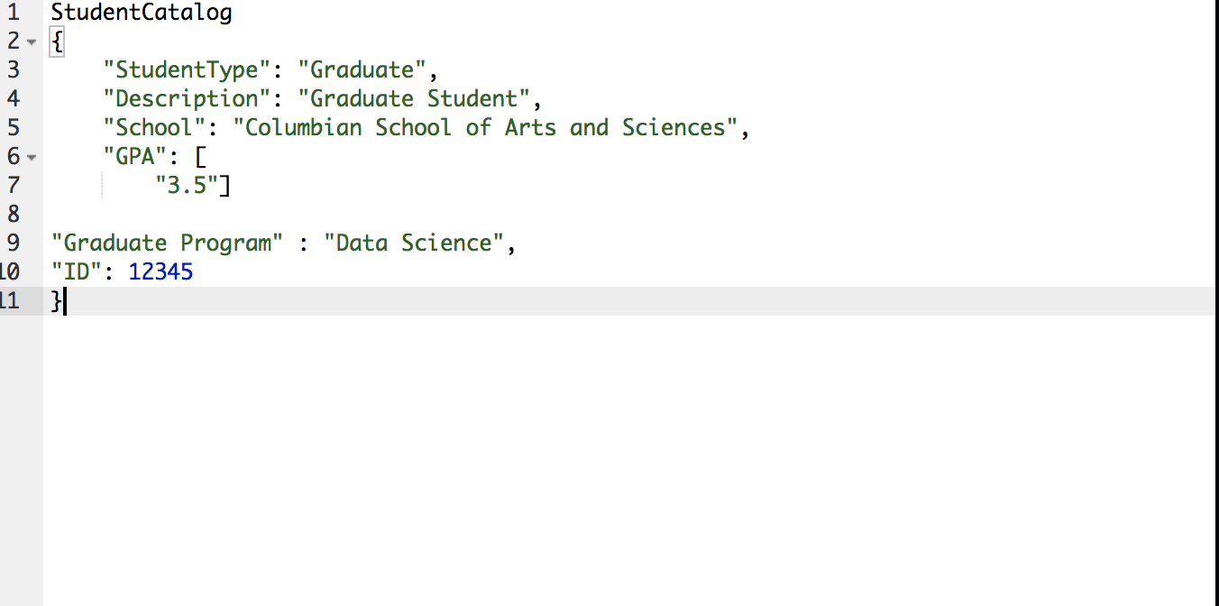
DynamoDB Table/Item Example

Slide 21
DynamoDB Internals
Table
Collection of items
Each Item is a collection of attributes
Partition Key – simple primary key uniquely identifies item in table; composed of one attribute
Composite Primary Key (Partition Key + Sort Key)
Secondary index – execute query more flexibly
Streams
Capture data modification events in DynamoDB tables
Size limits on the following components
Tables, items and attributes
Primary key
Secondary indexes
Streams

Slide 22
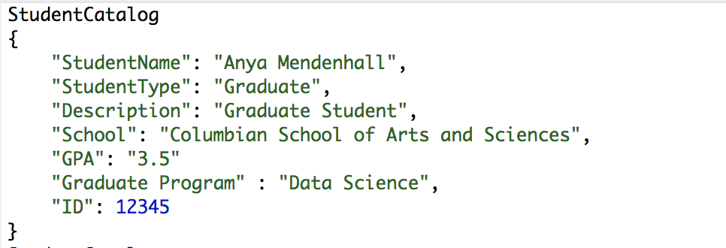
DynamoDB Table
Table – collection of data
Core unit of data in DynamoDB

Slide 23
DynamoDB Table
When creating table you have to specify:
TableName – name of the table
KeySchema – attributes that are used for primary key (table name and primary key is a must)
AttributeDefenitions – data types for the key schema attributes
ProvisionedThroughput – number of reads/writes per second that you need for this table

Slide 24
DynamoDB Table Operations
CREATE, UPDATE and DELETE
UpdateTable operation
Used to increase/decrease provisioned throughput
ListTables operation
List of all available tables associated with your account for a specific endpoint
DescribeTable operation
Get detailed information about the given table
Note: Cannot rename table

Slide 25
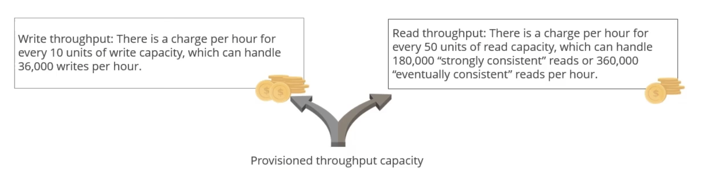
Provisioned Throughput

Slide 26
Item
Item
Each table has multiple items
Core unit of data in DynamoDB
Can compare to row in RDBMS
Each item is uniquely identifiable by a primary key that is set on table level
Each item is a group of attributes:
Bits of data on the item
E.g. ”Name” for user or “Year” for car.
Attributes have types (strings, numbers, lists, sets, etc.) – have to be provided when querying/writing items.

Slide 27
Item Operations
Item
Add attributes
Update attributes
Delete attributes

Slide 28
Attributes
Attributes
Fundamental data element, cannot be broken down further
Example – item in StudentCatalog table has attributes (StudentName, StudentType, Description, School, GPA, Graduate Program).
Like columns in RDBMS
Different elements of data on particular item
Most attributes in DynamoDB table are not required for every item
Can store different objects in one DynamoDB table
Each item must have attribute for defined primary key of the table

Slide 29
Attributes

Slide 30
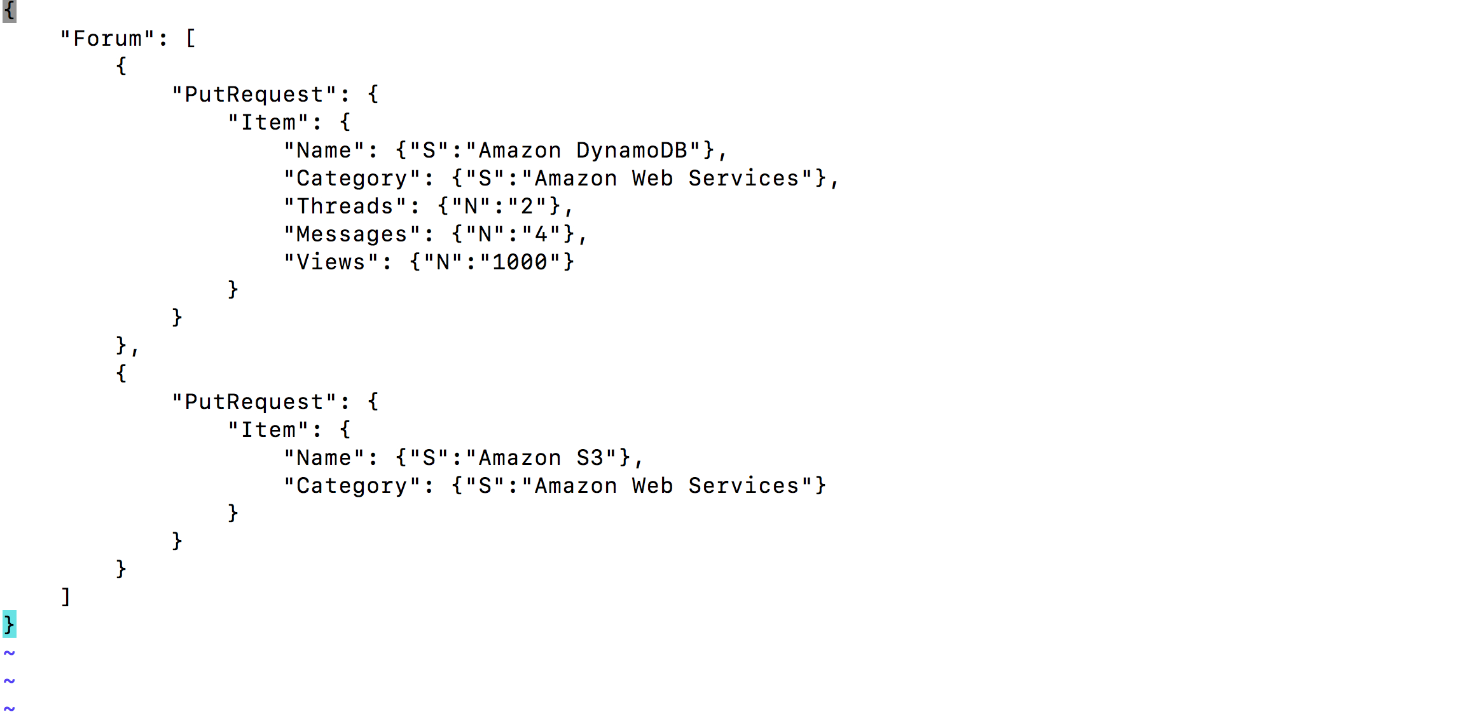
Attributes

Slide 31
Key points about StudentCatalog table
Each item in the table has unique identifier (primary key). In the StudentCatalog table the primary key consists of one attribute – ID
StudentCatalog table is schemaless – you don’t have to define attributes or their data types in advance
Most attributes are scalar – they only have one value
Some items have nested attributes

Slide 32
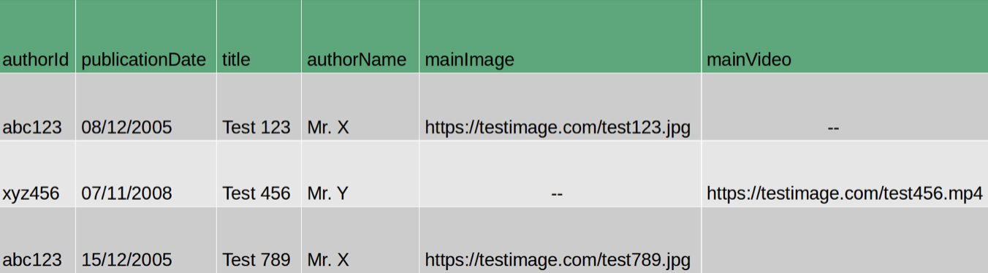
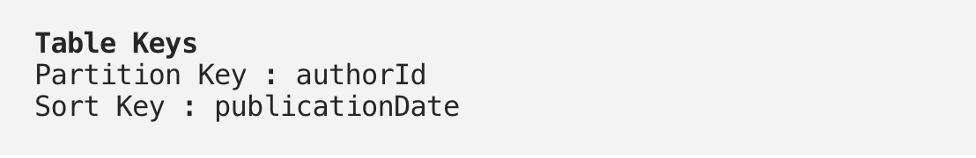
Attributes

Slide 33
Primary Key/Partition key
Primary Key
Uniquely identifies each item in the table
Have to define PK while creating table
Primary key cannot have NULL value
Two kinds of primary key
Partition Primary Key
Composite Primary Key (Partition + Sort Key)
Selecting Primary Key
Large number of distinct values

Slide 34
Primary/Partition key Key
Partition Primary Key
Also used for building an unordered hash index
Every item in DynamoDB represents logical key space
Distribute items by utilizing partition keys
Allow DynamoDB table to be partitioned for scale
Keyspace – represents grouping of outmost data, similar to schema concept in RDBMS. Every table in DynamoDB represents logical keyspace

Slide 35
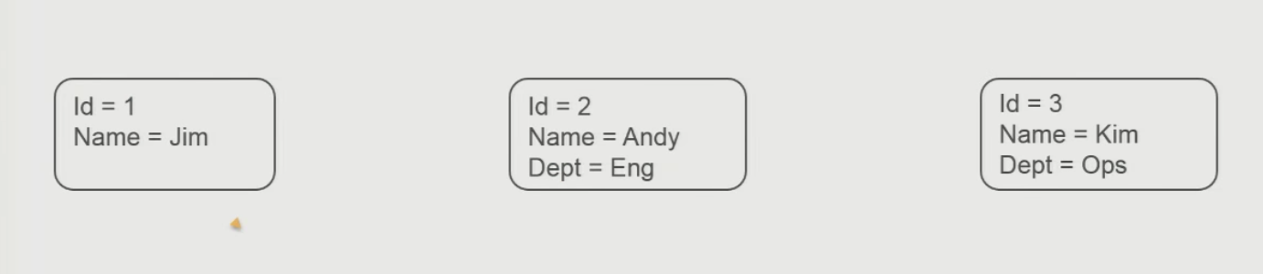
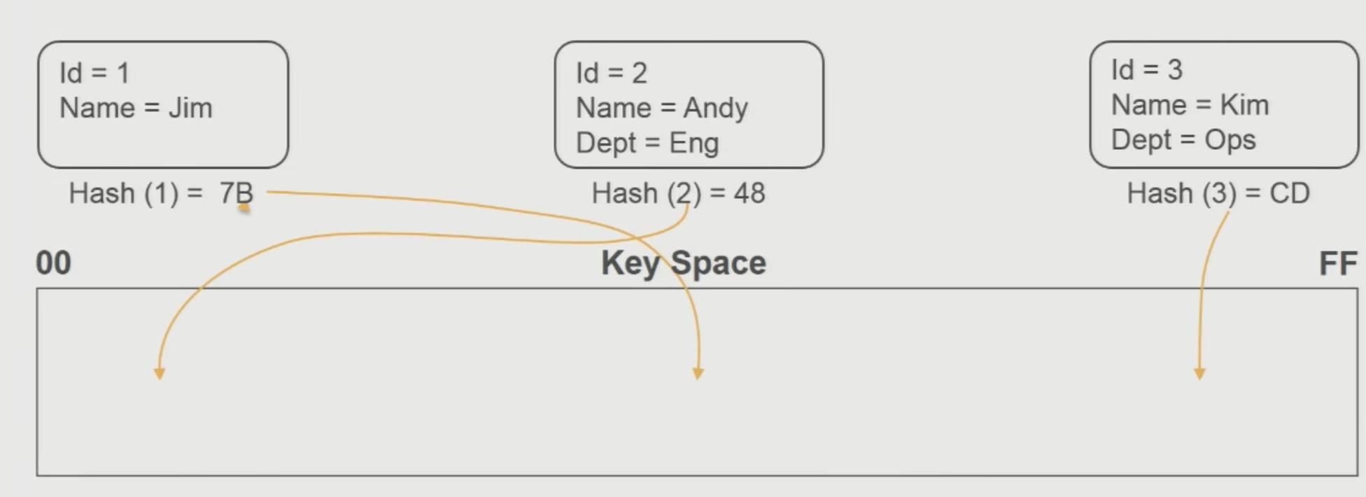
Partition Primary Key

Slide 36
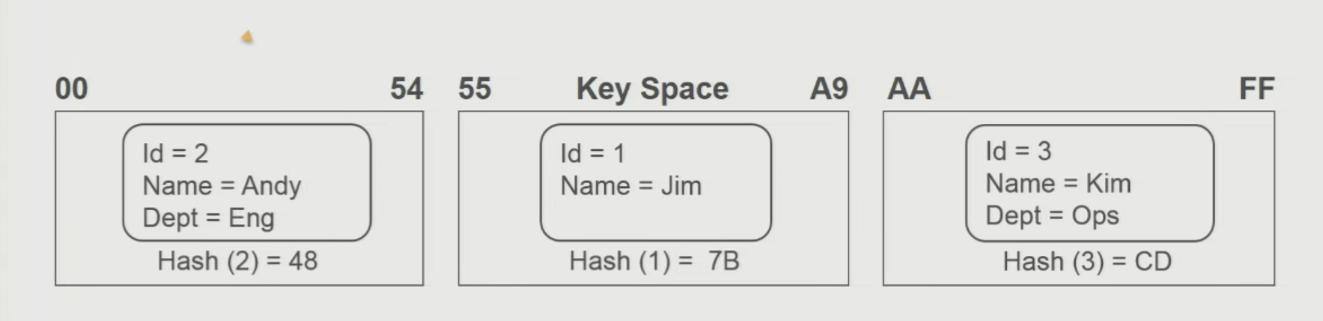
Partition Primary Key

Slide 37
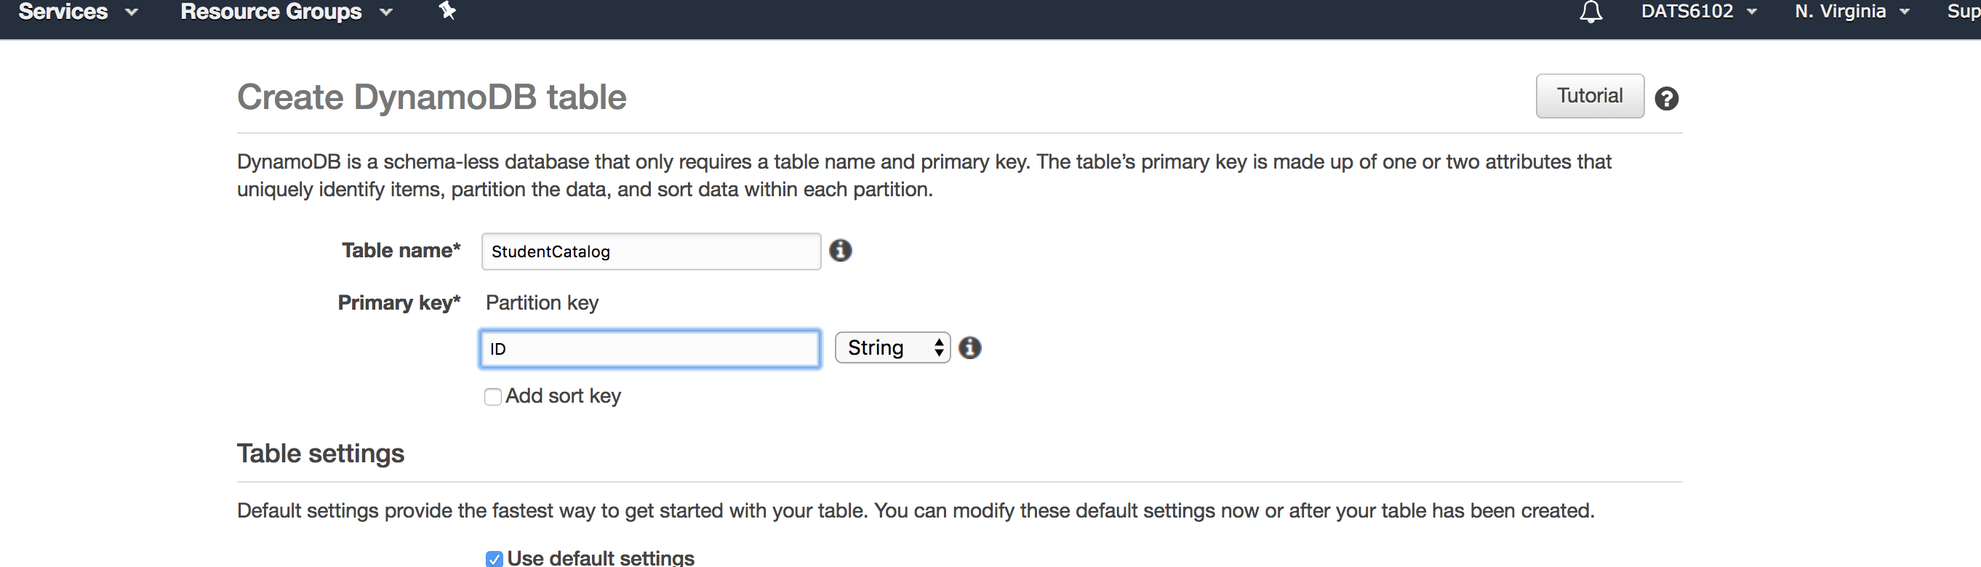
Partition Key
Create partition key by choosing key attribute

Slide 38
Sort Key
Also known as range key
Create partition key with sort key together to uniquely identify an item
There is no limit on the number of items per partition key
Except if you have local secondary indexes

Slide 39
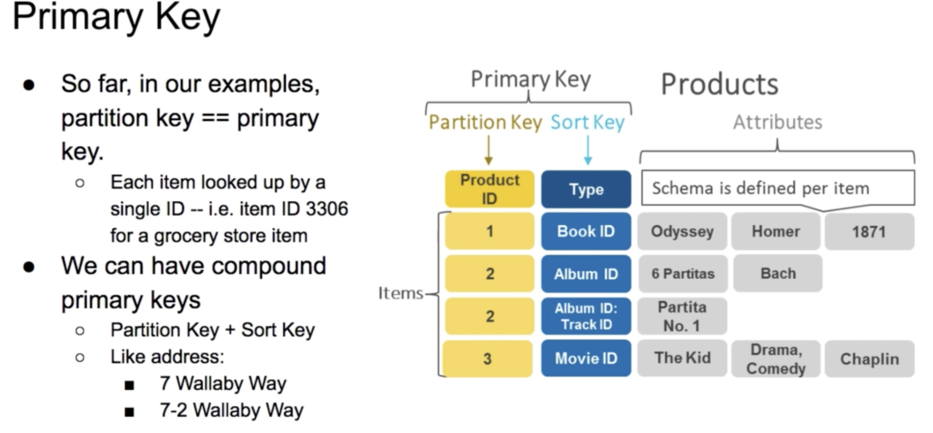
Composite Key – Partition and Sort

Slide 40
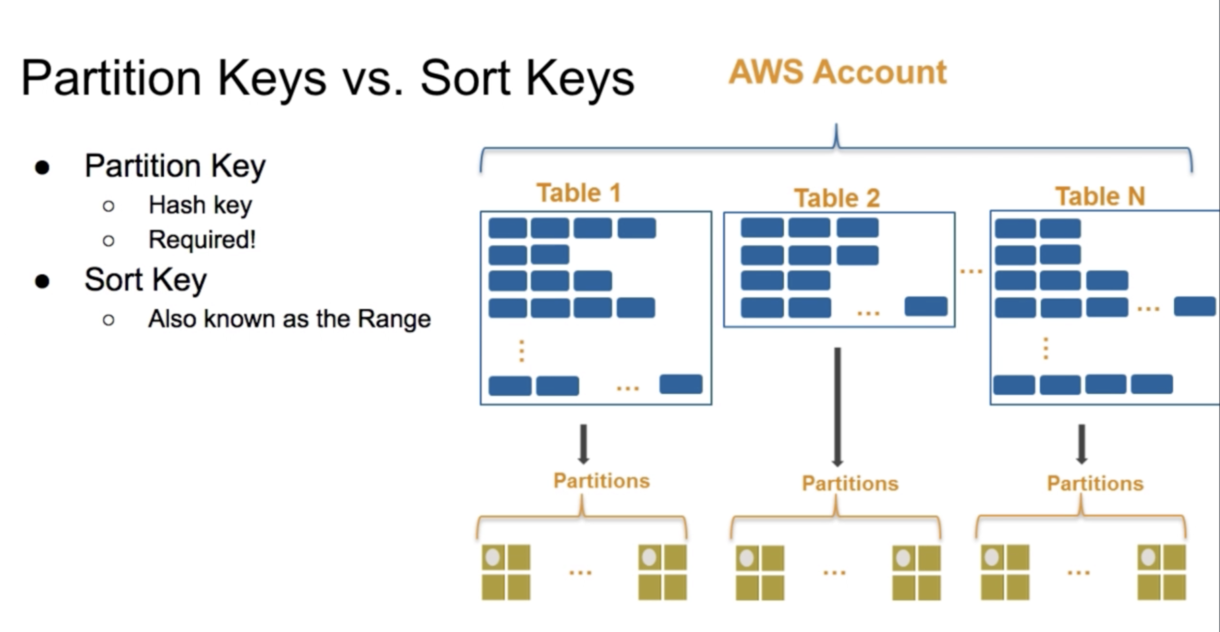
Composite Key

Slide 41
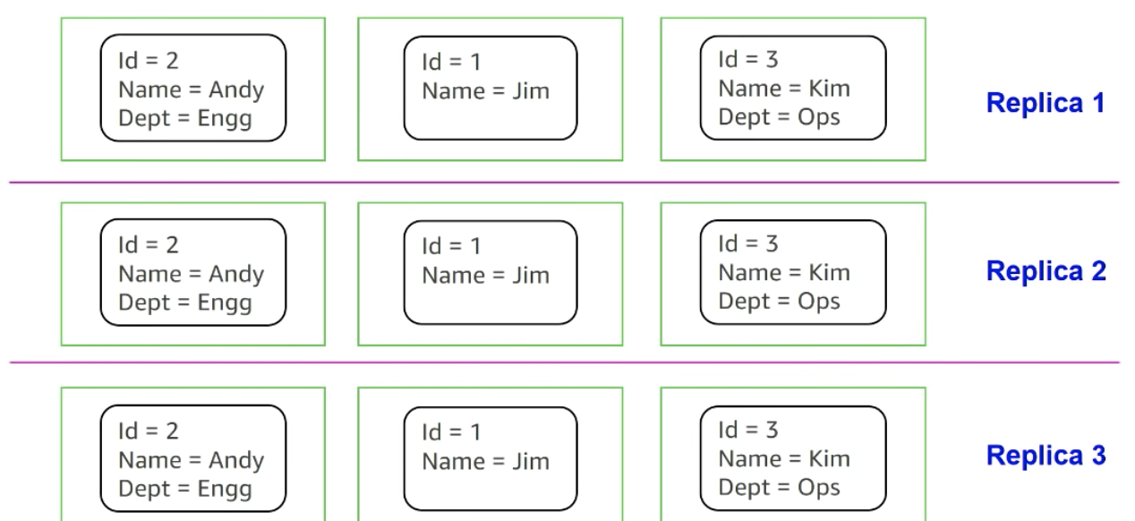
More on Partitions

Slide 42
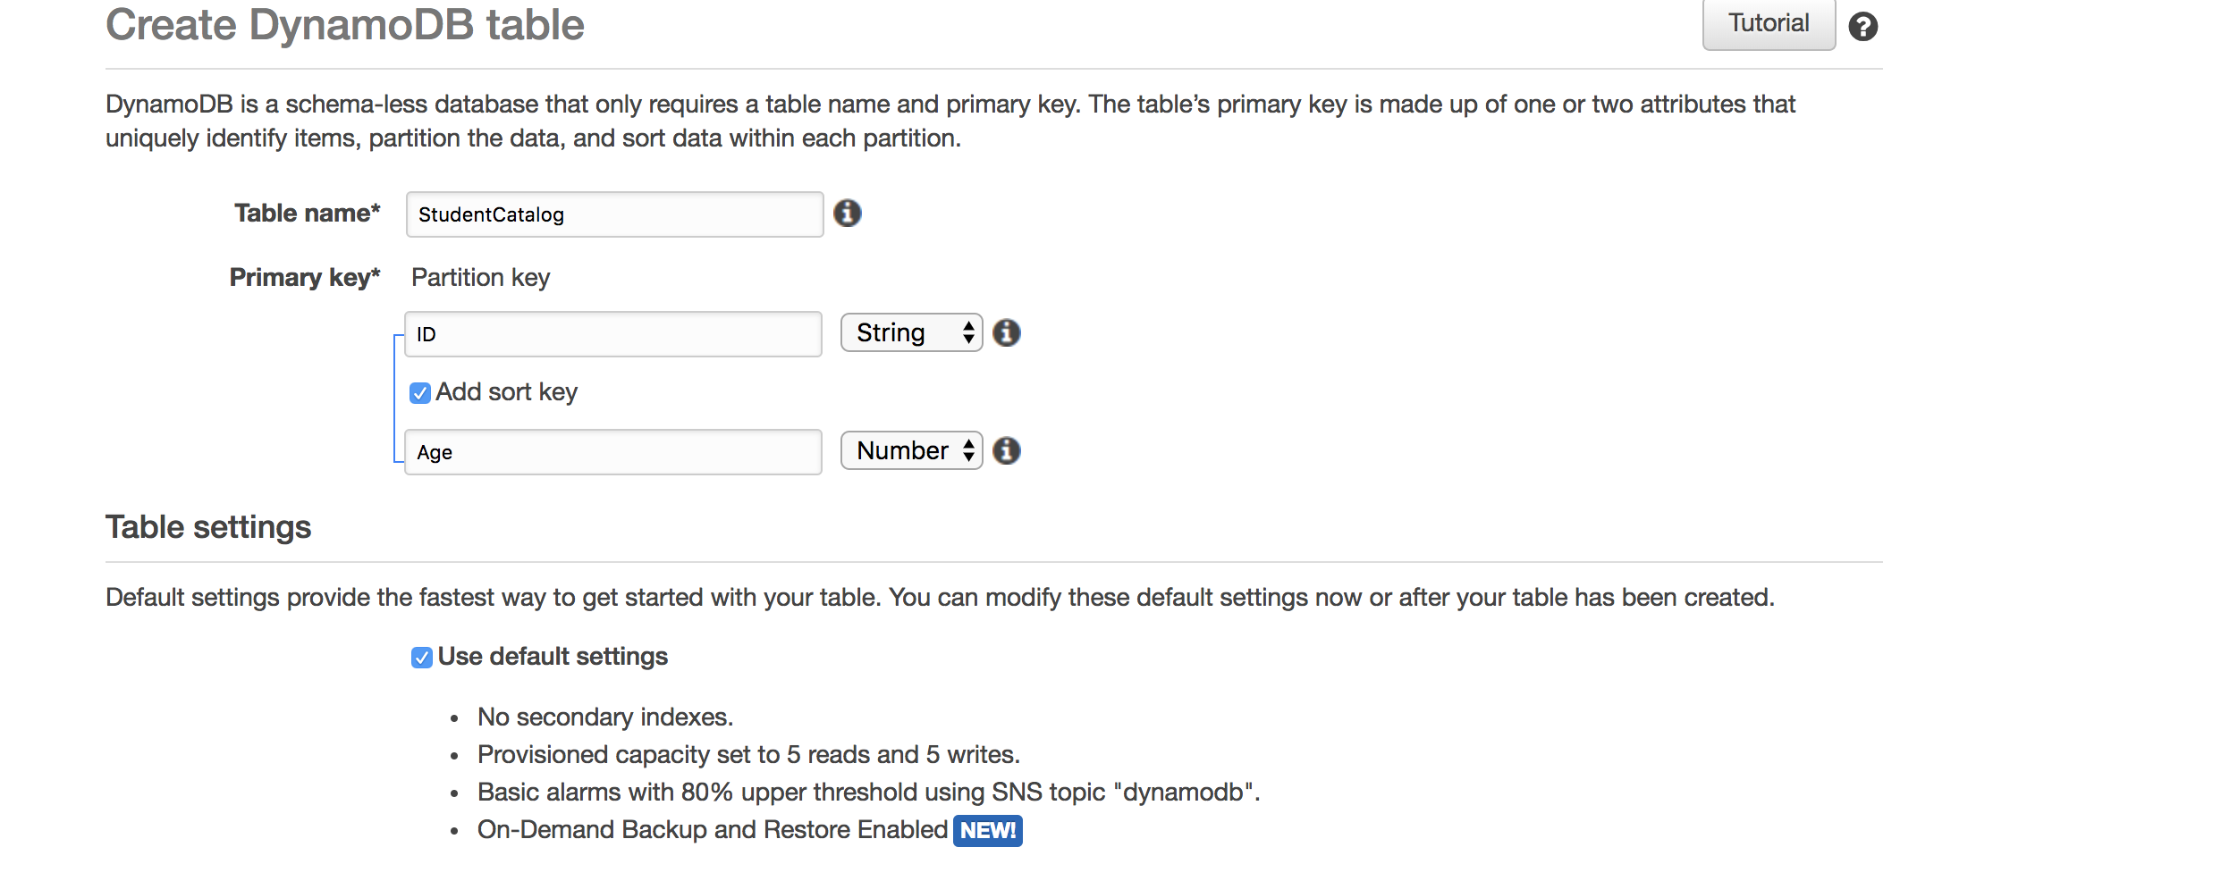
Composite Key
To create composite key – add sort key while creating table

Slide 43
Secondary Indexes
RDBMS – create index to perform fast queries
Create and database maintains it for you
Secondary Index - Dynamo allows to create an index on attribute other than Primary Key
Extend different query patterns to read data
Can speed up queries
Two types of secondary indexes:
Global Secondary Index
Local Secondary Index

Slide 44
Local Secondary Indexes
Local Secondary Index
Allow you to re-sort the data in the partitions
Have to create it during table creation
Cannot add or delete at the later point of time
Allows us to query only one partition, same as base table
Have to use partition key, which we created for the base table

Slide 45
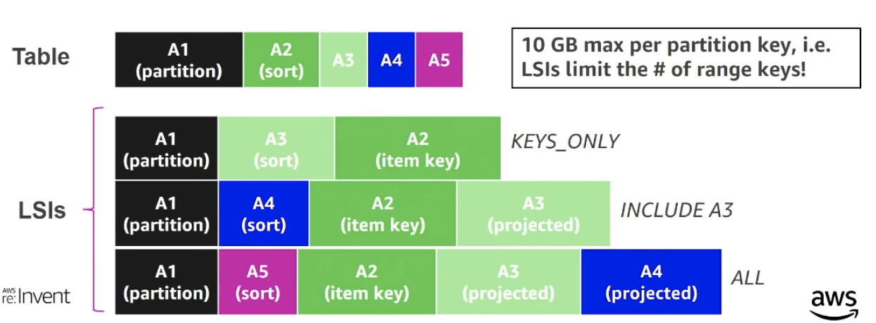
Local Secondary Indexes

Slide 46
Global Secondary Indexes
Global Secondary Index
Let you query across the entire table
Partition and sort key can be different from those in a table
Can create them during table creation or after
Allows us to query across multiple partitions
Use composite sort keys for compound indexes

Slide 47
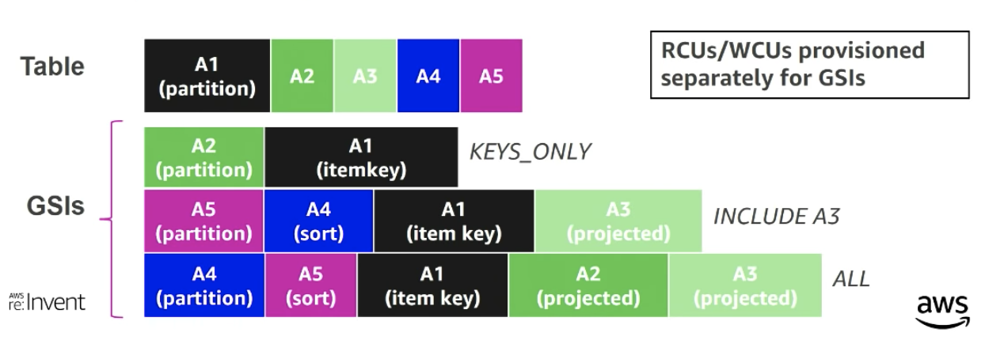
Global Secondary Indexes

Slide 48
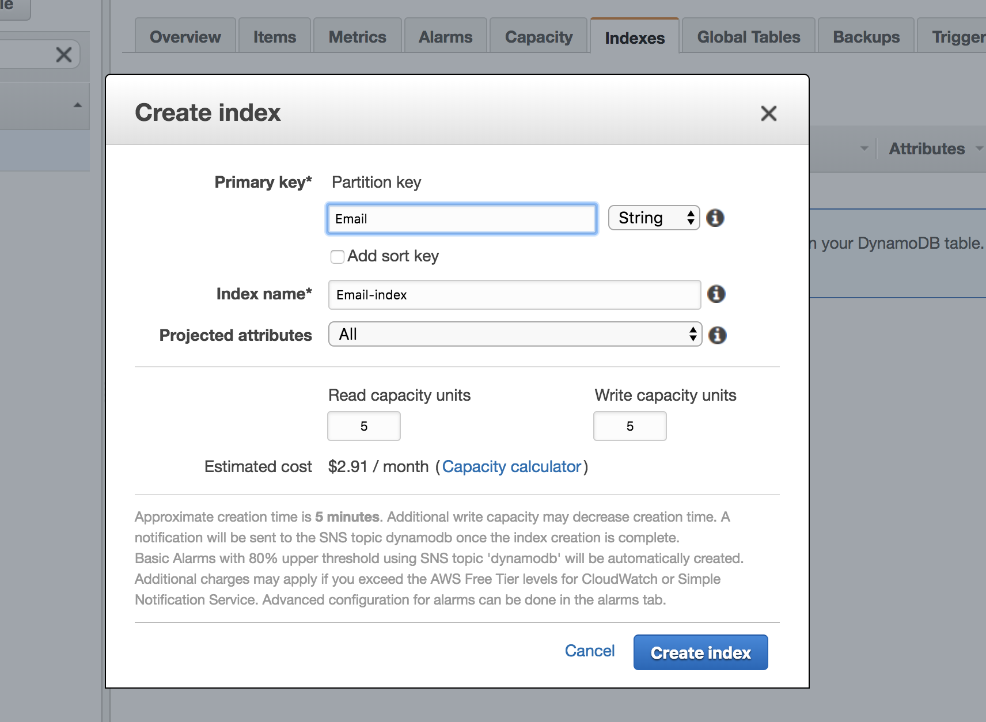
Global Secondary Indexes

Slide 49
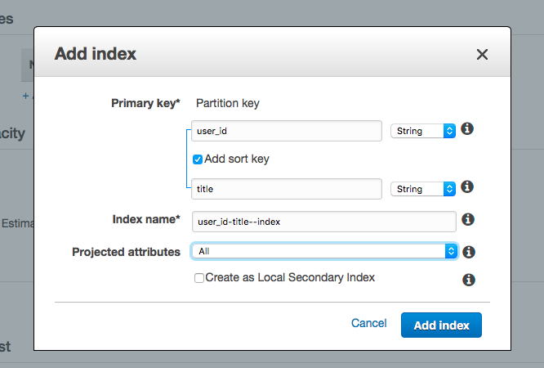
Global vs Local Index

Slide 50
Data types
DynamoDB supports:
Boolean
Byte
Int
Long
Float
Double
String
Date & Calendar
BigDecemal & BigInteger
List, Map

Slide 51
Data types
There Types:
Scalar type
Represents single value
String, number, Boolean, null, binary
Document type
Give you key-value pair of scalar types
Includes list and map types
Generally shown in JSON format
Set type
Group of multiple scalar types represented as array
String set, binary set, number set

Slide 52
Document Data types
List:
Store multiple values in order
Each value accessible using index
Schools = [”GWU”, “UVA”, “VCU”, “NYU”, “GMU”]
Map:
Represented as key-value pairs
Each value is accessible using the key
Key must be unique
Map of user’s age:
Users = {“John”:28, “Lisa”:29, “Sam”:31}

Slide 53
Document Data types (con’t)
Set Types:
Sets of number, string and binary values
All elements within set must be of the same type
Each value within set must be unique
No empty sets
stringSet = [“Black”, “Green”, “Red”]
numberSet = [42.2, -19, 7.5, 3.14]
binarySet = [“xy3?=”, “UzCPhk=”, “zj788shbd=“]

Slide 54
Streams
Feature local to DynamoDB
Allows you to see changes to your table items
Choose what you want to write to a stream
Keys only
Only key attribute of modified item will be written
New Image
Will write the item to the stream as it appears once it has been modified
Old Image
Will write item as it appeared before it was changed
New and Old Image
Both new and old image is written once item been changed

Slide 55
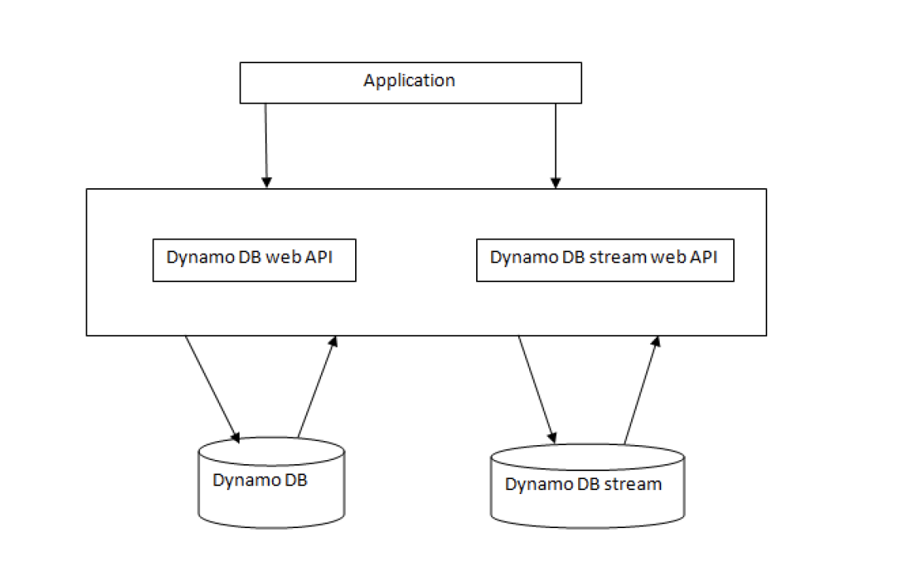
Streams
Create/Update/Delete item = DynamoDB stream will write a stream record

Slide 56
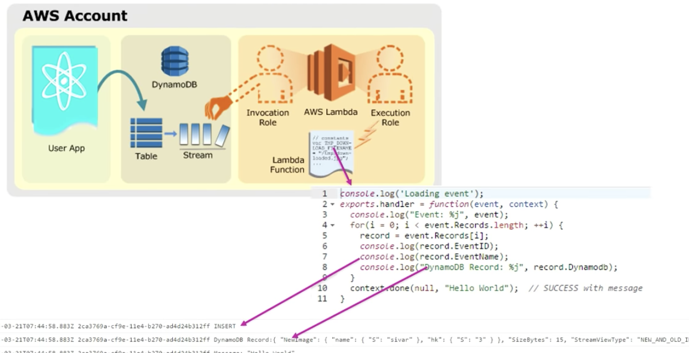
DynamoDB Streams and AWS Lambda

Slide 57
DynamoDB Supported Operations
Table operations
Create, Update and Delete tables
Item operations
Add, update and delete items from a table
Retrieve a single or multiple items
Query and Scan
Query using table index or primary key or any created secondary indexes

Slide 58
Reading Data From a Table
RDBMS
Use SELECT to get data
Also use WHERE clause to further restrict data parameters
DynamoDB
GetItem
Retrieves single item from table
BatchGetItem – up to 100 GetItem calls in a single operation
Query
Retrieves all items with specific partition key
BatchGetItem – up to 100 GetItem calls in a single operation
Scan
Retrieves all items in a specified table
Notes:
.

Slide 59
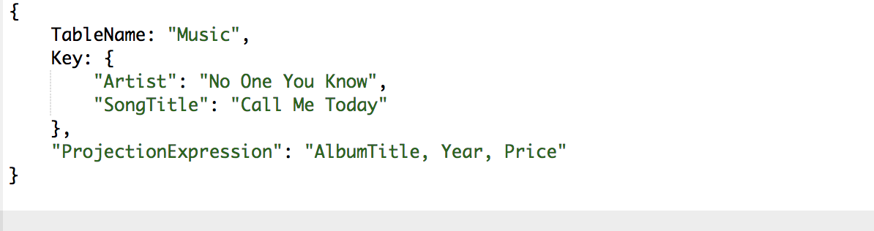
Reading Item Using Primary Key
GetItem action
Retrieve item by primary key
By default returns entire table
Can specify parameters by using ProjectionExpression

Slide 60
Querying a Table
Query
Retrieve data based on some criteria
Can query with any table that has composite primary key (partition key and sort key)
Must specify equality condition for partition key and optionally condition for sort key
KeyCondtionExpression – specify key values you want to query
Must use ExpressionAttributeValues in expression parameters
Notes:
.

Slide 61
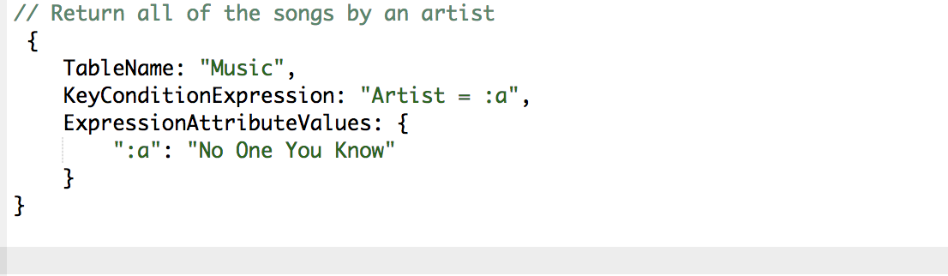
Querying a Table
Notes:
.

Slide 62
Scan
Scan
SQL – SELECT without WHERE returns all rows
Can specify filter criteria to manage search results
Consume large amounts of system resources
Use SCAN for small tables or bulk export of data
Provides FilterExpression parameter
Use to filter
Applied after the entire table is scanned
Notes:
.

Slide 63
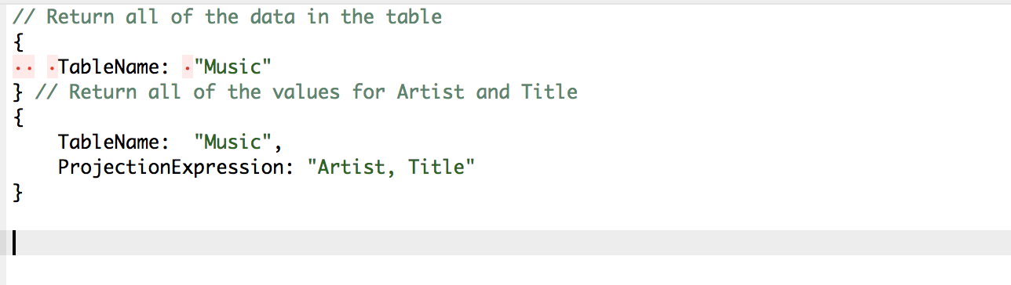
Scan
Notes:
.

Slide 64
Query vs Scan
Performance
Query is more efficient than scan operation
Query works on limited set of items
Scan works on the whole table
Scan first returns entire table → applies filters
Query depends on amount of data
Query results can be either eventually consistent or optionally strongly consistent
Scan – eventually consistent only
Notes:
.

Slide 65
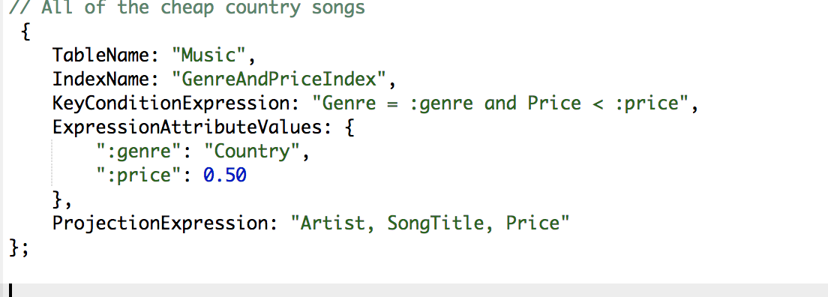
Querying and Scanning an Index
Perform query operations directly on index
Specify both table and index name

Slide 66
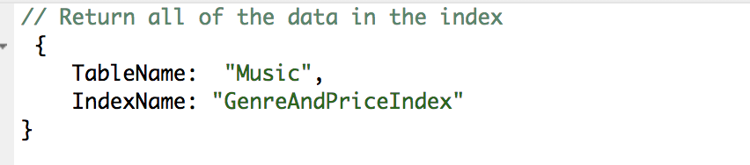
Querying and Scanning an Index
Can perform scan operations on secondary index
Specify both table and index name

Slide 67
Parallel Scan
Scan operation works on one partition at the time
Leads to underutilization of the provisioned throughput
Parallel Scan divides table into multiple segments
Multiple treads and processes work on a single segment at a time.
Each retrieve 1 MB of data every time
Best use when we integrate DynamoDB with other AWS services
Example: AWS Redshift (import/export allows max utilization of provisioned resources)
Notes:
.

Slide 68
Limit and Counts
LIMIT
Limits results of query or scan to a specified number
Similar to RDBMS LIMIT (in MySQL)
COUNT
Set COUNT parameter to TRUE in Query or Scan
Instead of actual data set will get count of matching items
Data size limit is applied to Query or Scan counts also

Slide 69
Modifying Table Data
RDBMS
Use UPDATE to modify data
DynamoDB
UpdateItem action
Modify single item
Use multiple UpdateItem actions for multiple updates
Must specify key attributes
Must specify UpdateExpression to specify attribute values
Acts like UPDATE and INSERT

Slide 70
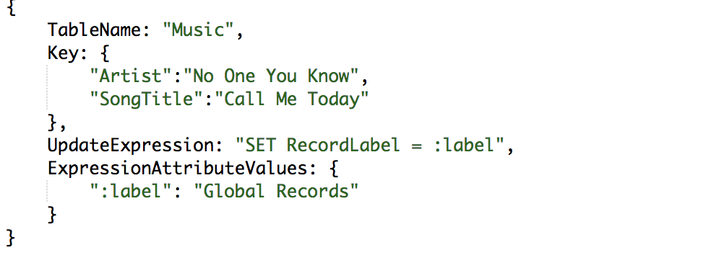
Modifying Table Data

Slide 71
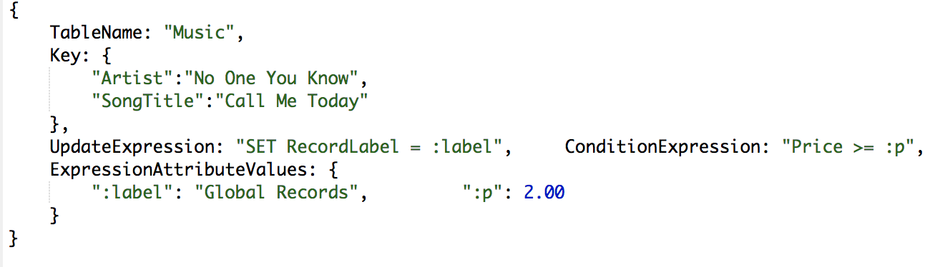
Modifying Table Data
UpdateItem supports conditional writes
Operations succeeds only if UpdateExpression evaluates to true

Slide 72
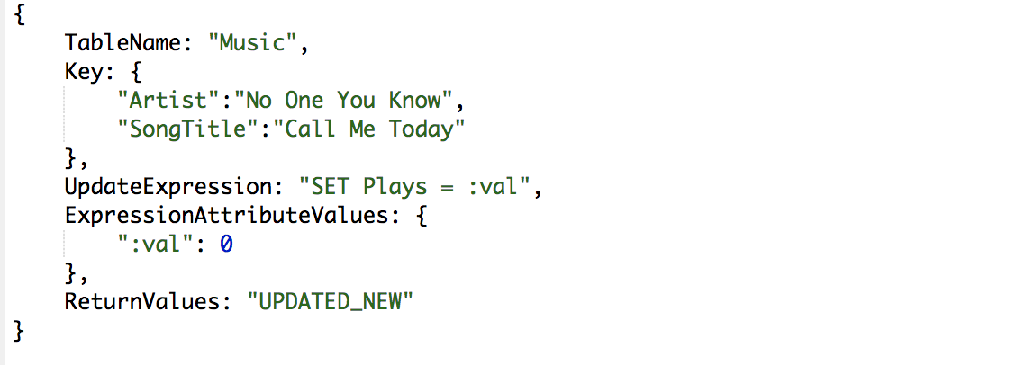
Modifying Table Data
UpdateItem supports atomic counters
Attributes of type Number
Similar to RDBMS sequences

Slide 73
Deleting Table Data
RDBMS
DELETE removes one or ore rows from table
Use WHERE to specify which rows to delete
DynamoDB
DeleteItem operation deletes one item at the time
Support Conditional Writes
Operation succeeds if a specific ConditionExpression evaluates to true

Slide 74
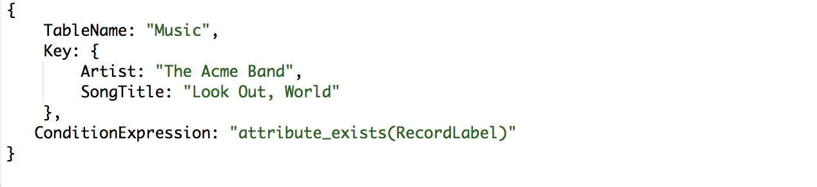
Deleting Table Data

Slide 75
Remove Table
RDBMS
DROP TABLE drops table permanently
DynamoDB
DeleteTable operation deletes table permanently

Slide 76
Sources
https://www.dynamodbguide.com/the-dynamo-paper
Amazon DynamoDB: Developer Guide
Seven No SQL Databases in a Week
AWS re:Invent Series 2018

Slide 77
Lab

Slide 78
Reading Assignment: Dan Sullivan Chapter 5

